Slide 1


INTEGRATION OF CHATGPT WITH WHATSAPP
SHAKIR MALIK
TAWHEED MUSAIB
TAZEEM NAZIR
IFTISAM TARIQ
POONAM BHALWAL

Slide 2
CONTENT
PROBLEM STATEMENT
SOLUTION
ARCHITECTURE
VIDEO DEMONSTRATION
USE CASES
CONCLUSION
TECH STACK
REFERENCES

Slide 3
PROBLEM STATEMENT
“To make a ChatGPT easily accessible and
make WhatsApp bots more useful”
ChatGPT is indeed one of the leading AI-based websites that can assist in every field.
It can provide specific information about any domain, playing an important role in our daily lives.
While ChatGPT is easily accessible on laptops or PCs, using it on mobile devices presents challenges, as it's not as convenient to carry a laptop everywhere.

Slide 4
SOLUTION
Our project offers a solution to the given problem.
Considering that everyone here uses WhatsApp.
The aim of the project is to integrate ChatGPT with WhatsApp, enabling everyone to harness the power of ChatGPT from anywhere.
This project can assist anyone and is user-friendly since everyone is familiar with using WhatsApp.
Aim is to create the responsive bots that can react with the use.

Slide 5
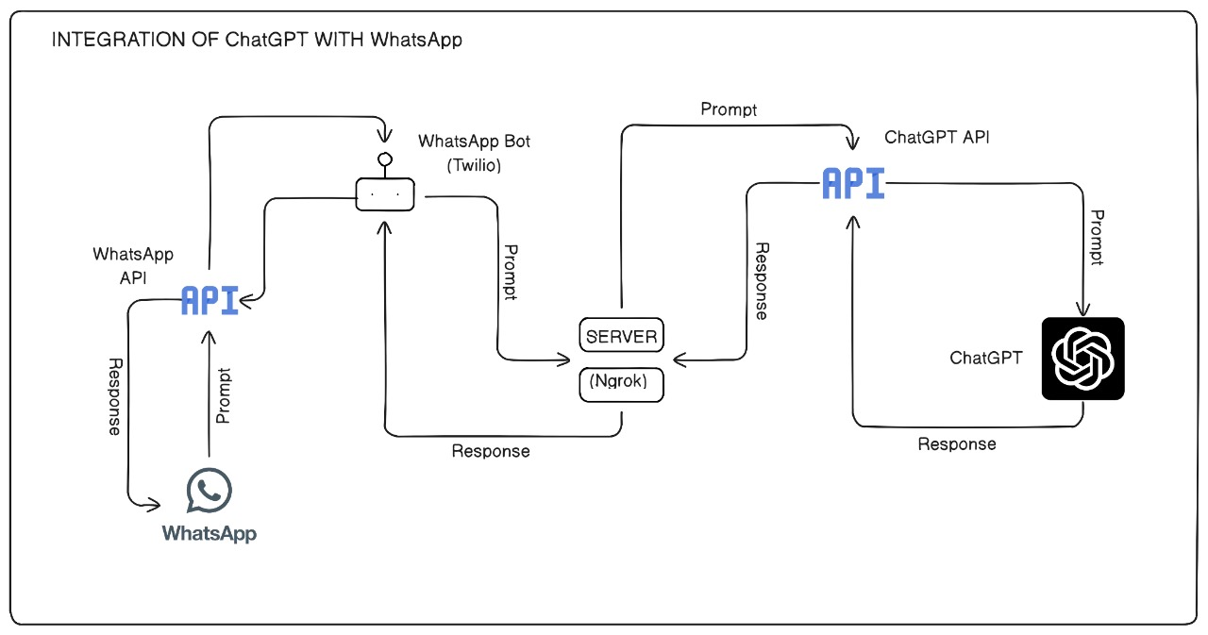
ARCHITECTURE

Slide 6
VIDEO DEMINOSTRATION

Slide 7
USE CASES
Customer Support:
Business can make responsive bot for their customer support.
Education Assistance:
Students can use it for educational purposes.
Information Retrieval:
Information can be retrieved easily.
Business Inquiries:
Business can make responsive bot for their customers by which customers can get information about different product and services easily.

Slide 8
TECH STACK
LANGUAGE:
PYTHON
API(S):
OpenAI
WhatsApp API
TECHNOLOGY:
NGROK
Twillio

Slide 9
CONCLUSION
Aim is to handle the user query using the ChatGPT.
In future we are looking to upgrade it by making the own Language Model (LM).
The LM can handle the user query and provide some additional features.
It will handle the image processing and also accepts the voice messages.

Slide 10
REFERENCES
[1] "AltexSoft.com," [Online]. Available: https://www.altexsoft.com/blog/languagemodels-gpt/.
[2] "ibm.com," IBM, [Online]. Available: https://www.ibm.com/topics/naturallanguage-processing.
[3] "AWS," Amazon, [Online]. Available: https://aws.amazon.com/what-is/gpt/.
[4] "ChatGPT," OpenAI, [Online]. Available: chat.openai.com.
[5] "Postman," Postman, [Online]. Available: https://www.postman.com/what-is-anapi/.
[7] "freshworks.com," Freshworks, [Online]. Available:
https://www.freshworks.com/live-chat-software/customer-engagement/build-awhatsapp-bot-blog/.

Slide 11
THANK YOU

